Slide 1

Estimating & Removing Trends
Dr. Abolfazl Saghafi
Assistant Professor of Statistics & Data Science
Notes:
We continue this week by discussing ways to remove trends from non-stationary time series.

Slide 2
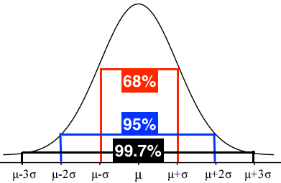




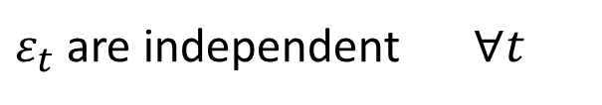


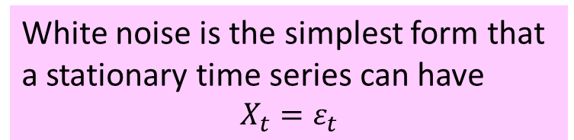




White Noise
White noise is the simplest form that a stationary time series can have
$$X_{t}=ε_{t}$$
A time series is said to be white noise and is shown specifically by $ε_{t}$ when
White noise in short is shown by
$$ε_{t} \sim ^{i.i.d} N\left(0,σ\right)$$
①
$ε_{t} \sim Normal$ $∀t$
②
$ε_{t}$ are independent $∀t$
$$⇒$$
$E\left(ε_{t}ε_{s}\right)=E\left(ε_{t}\right) E\left(ε_{s}\right)$ $∀t≠s$
③
$E\left(ε_{t}\right)=0$ $∀t$
$E\left(ε_{t}ε_{s}\right)=0$ $∀t≠s$
②
③
$$⇒$$
④
$Var\left(ε_{t}\right)=σ^{2}$ $∀t$
That is fixed, series bandwidth
does not change with time
①
②
$Cov\left(ε_{t},ε_{s}\right)=0=Corr\left(ε_{t},ε_{s}\right)$ $∀t≠s$
$$⇒$$
Notes:
Normal distribution of noise is our main assumption, some other types of noise will be discussed in future sessions.

Slide 3
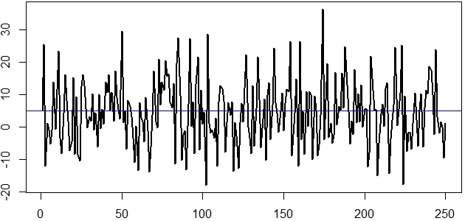
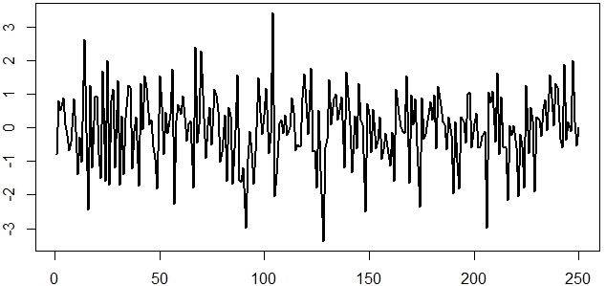



$$X_{t}=5+ε_{t}$$
$$ε_{t} \sim ^{i.i.d} N\left(0, 10\right)$$
$$ε_{t} \sim ^{i.i.d} N\left(0, 1\right)$$
• If you generate summary statistics such as mean and var, values will be close to 5 and 100 but not exactly the same, this is a simulation afterall
• Fluctuates around its mean, 0
• No trend
• Spread mostly (99%) in (-3, 3), since standard deviation is 1
• If you were given a time series like the ones above, not knowing anything about the two parameters μ and σ, you can simply estimate them using mean and std of the whole series
• Fixed bandwidth through time
• No obvious pattern
Notes:
Ex1. Right. Standard normal white noise
Ex2. Left. There is a constant trend there, only intercept exist there.
Follow the codes on R session

Slide 4
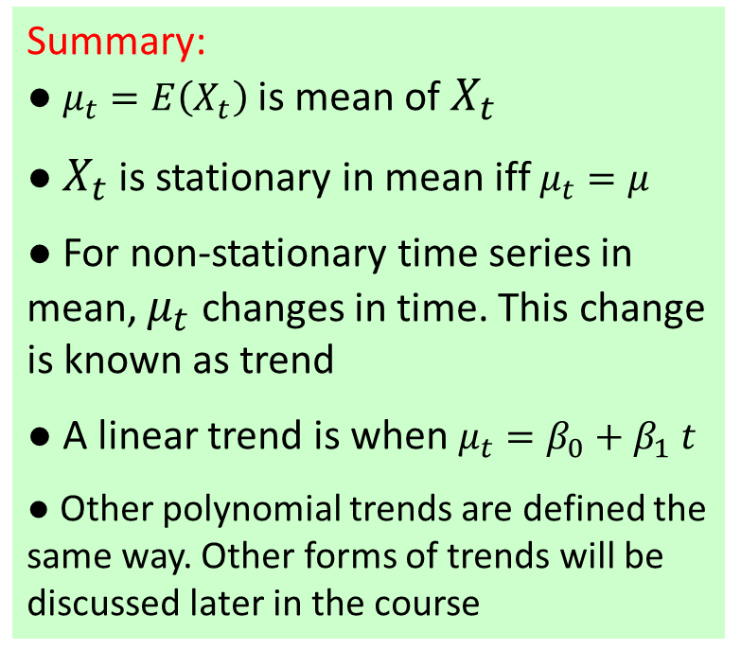
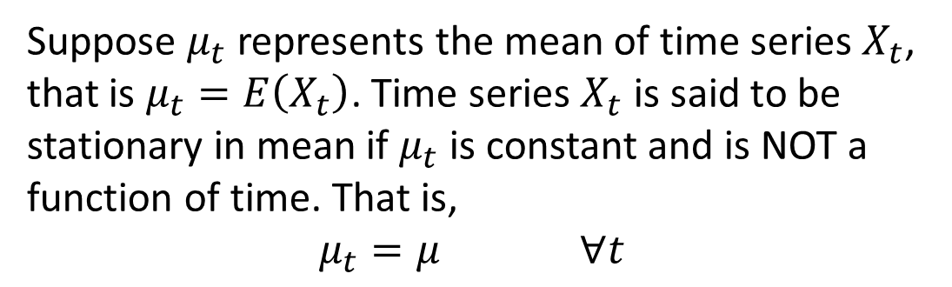

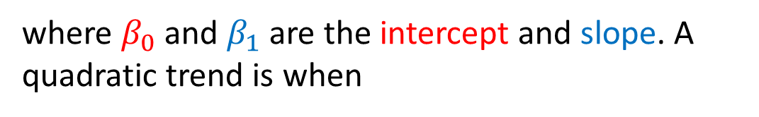


Trends
Summary:
● $μ_{t}=E\left(X_{t}\right)$ is mean of $X_{t}$
● $X_{t}$ is stationary in mean iff $μ_{t}=μ$
● For non-stationary time series in mean, $μ_{t}$ changes in time. This change is known as trend
● A linear trend is when $μ_{t}=β_{0}+β_{1} t$
● Other polynomial trends are defined the same way. Other forms of trends will be discussed later in the course
Suppose $μ_{t}$ represents the mean of time series $X_{t}$, that is $μ_{t}=E\left(X_{t}\right)$. Time series $X_{t}$ is said to be stationary in mean if $μ_{t}$ is constant and is NOT a function of time. That is,
$μ_{t}=μ$ $∀t$
Trend is then the way $μ_{t}$is expressed in time. For example, a linear trend is when
$$μ_{t}=β_{0}+β_{1} t$$
If trend is present in a time series, we need to remove it before modeling since probabilistic modeling is only developed for stationary time series
where $β_{0}$ and $β_{1}$ are the intercept and slope. A quadratic trend is when
$$μ_{t}=β_{0}+β_{1} t+β_{2} t^{2}$$
Notes:
First, lets see what trends are and how to properly formulate them

Slide 5
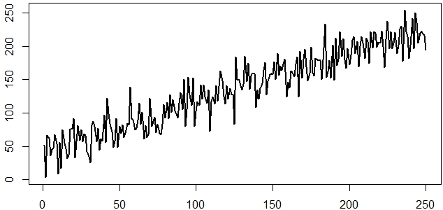
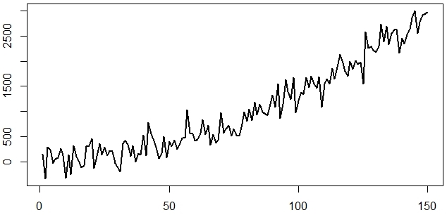








$$X_{t}=μ_{t}+ε_{t}$$
$$t=1,2,…,250$$
$$μ_{t}=40+0.75 t$$
$$ε_{t} \sim ^{i.i.d} N\left(0, 10\right)$$
$$X_{t}=μ_{t}+ε_{t}$$
$$t=1,2,…,150$$
$$μ_{t}=40+0.5 t+0.125 t^{2}$$
$$ε_{t} \sim ^{i.i.d} N\left(0, 200\right)$$
Notes:
Check out these examples in the accompanied R session

Slide 6
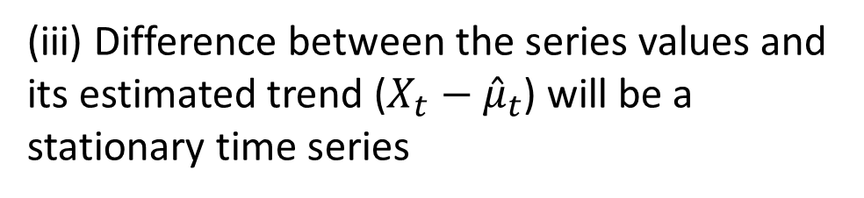
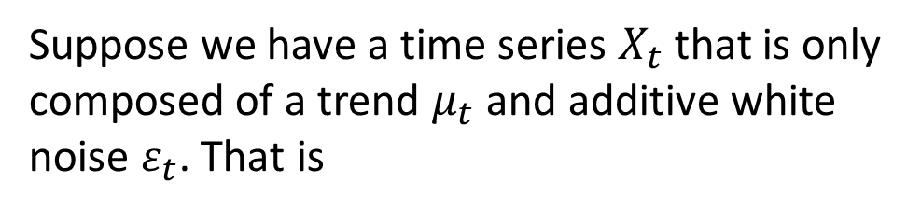
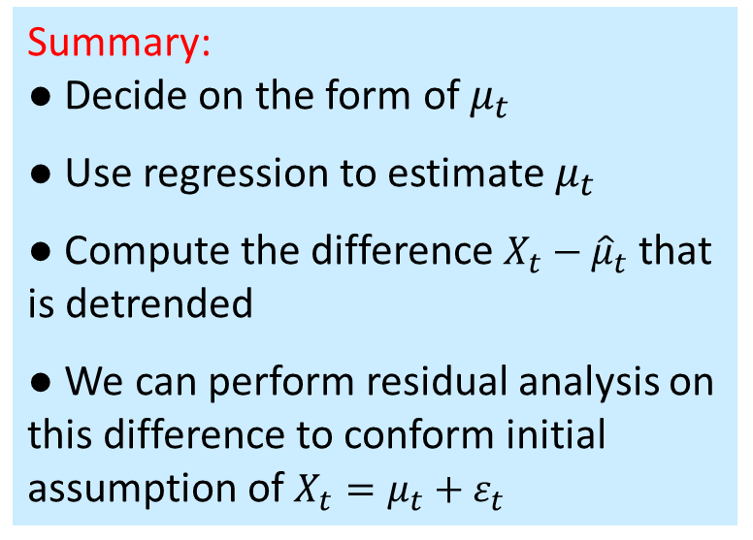
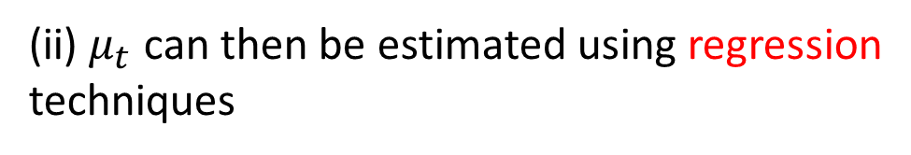
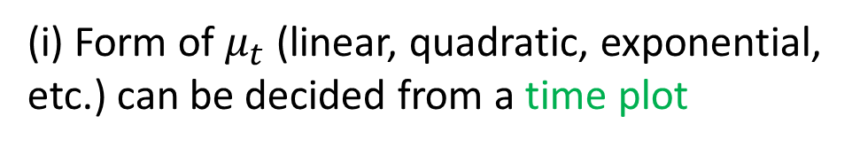

1. Estimating Trends
Summary:
● Decide on the form of $μ_{t}$
● Use regression to estimate $μ_{t}$
● Compute the difference $X_{t}−{\hat{μ}}_{t}$ that is detrended
● We can perform residual analysis on this difference to conform initial assumption of $X_{t}=μ_{t}+ε_{t}$
Suppose we have a time series $X_{t}$ that is only composed of a trend $μ_{t}$ and additive white noise $ε_{t}$. That is
$$X_{t}=μ_{t}+ε_{t}$$
(i) Form of $μ_{t}$ (linear, quadratic, exponential, etc.) can be decided from a time plot
(ii) $μ_{t}$ can then be estimated using regression techniques
(iii) Difference between the series values and its estimated trend ($X_{t}−{\hat{μ}}_{t}$) will be a stationary time series
Notes:
The first technique to remove the trend is to estimate them first using regression and then remove them by subtracting it from the time series

Slide 7
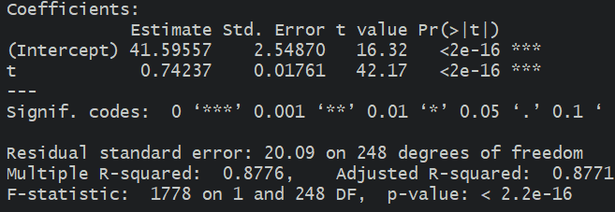
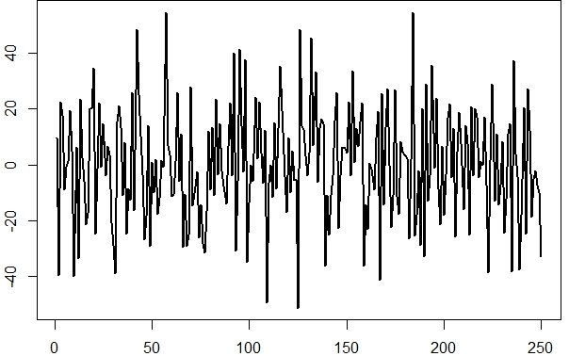



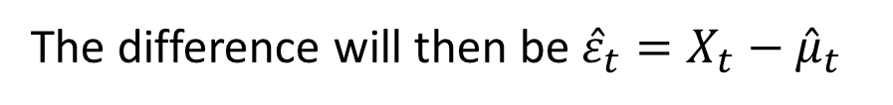
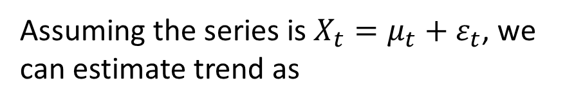

Example
The simulated time series $X_{t}$ is given.
It is obviously non-stationary with a linear trend.
Assuming the series is $X_{t}=μ_{t}+ε_{t}$, we can estimate trend as
$${\hat{μ}}_{t}=\left(41.60+0.74 t\right)$$
$$\hat{σ}=20.09$$
The difference will then be ${\hat{ε}}_{t}=X_{t}−{\hat{μ}}_{t}$
Residual analysis should be performed to confirm that ${\hat{ε}}_{t}$is white noise

Slide 8
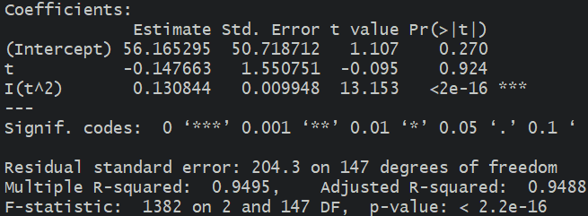
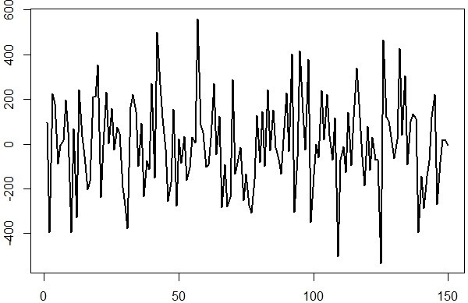

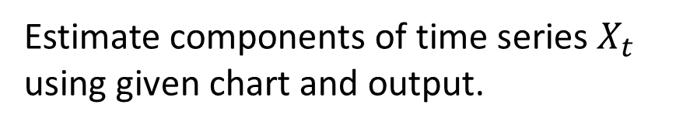


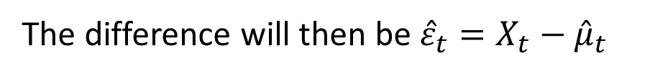
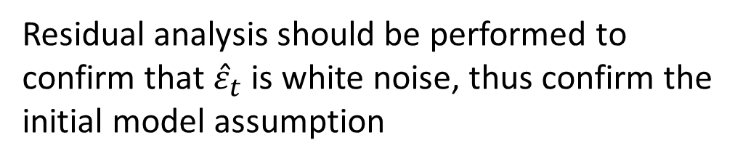
Example
Estimate components of time series $X_{t}$ using given chart and output.
Assuming that it is $X_{t}=μ_{t}+ε_{t}$, we can estimate $μ_{t}$as
$${\hat{μ}}_{t}=\left(56.17−0.15 t+0.13 t^{2}\right)$$
$$\hat{σ}=204.3$$
The difference will then be ${\hat{ε}}_{t}=X_{t}−{\hat{μ}}_{t}$
Residual analysis should be performed to confirm that ${\hat{ε}}_{t}$is white noise, thus confirm the initial model assumption
Notes:
VERY IMPORTANT: you can see that effect of t is not significant but you cannot drop that term from the model since its higher term t^2 is significant
Some estimations here are not that close to actual values, the reason is high level of noise

Slide 9
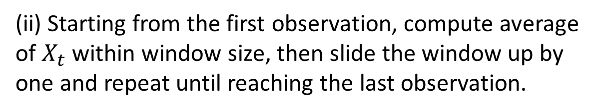
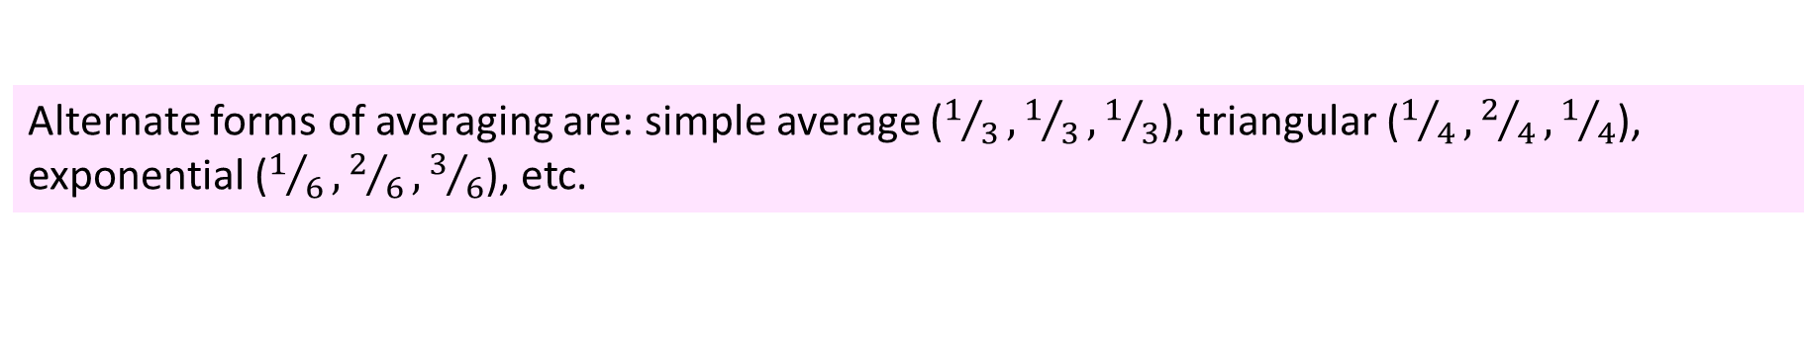
2. Moving Average Filter
Note:
• The higher the window size, the smoother the series after filtering
• Using a window size of 3, you will lose 2 observation; 4 for window size of 5 etc.
If high level of noise prevent you from correctly spotting trends and their form, you can pass the series though a moving average filter.
(i) Assign a window size, usually a odd number, 3, 5, etc.
(ii) Starting from the first observation, compute average of $X_{t}$ within window size, then slide the window up by one and repeat until reaching the last observation.
22 26 24 28 29 27 31 32 33 34
*
24 26 27 28 29 30 32 33
*
Alternate forms of averaging are: simple average ($1/3,1/3,1/3$), triangular ($1/4,2/4,1/4$), exponential ($1/6,2/6,3/6$), etc.
Notes:
We can used moving average filter to estimate trend and then proceed to remove it from the time series. See examples in the R session

Slide 10
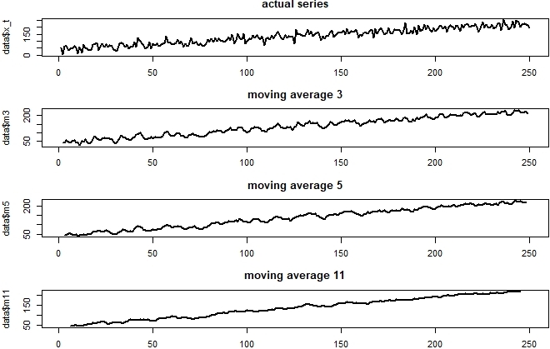
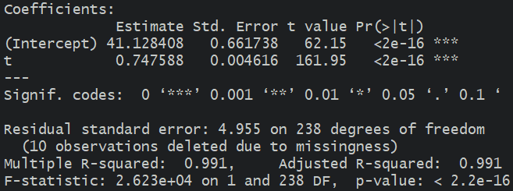

Slide 11
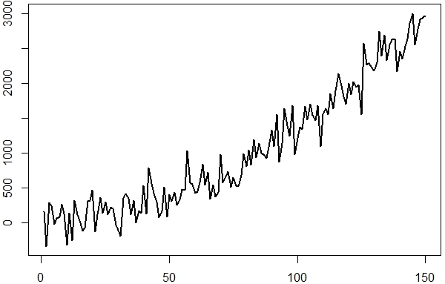
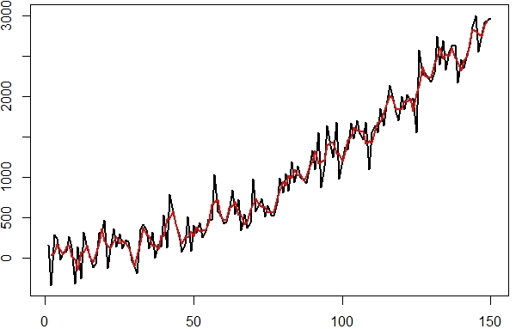
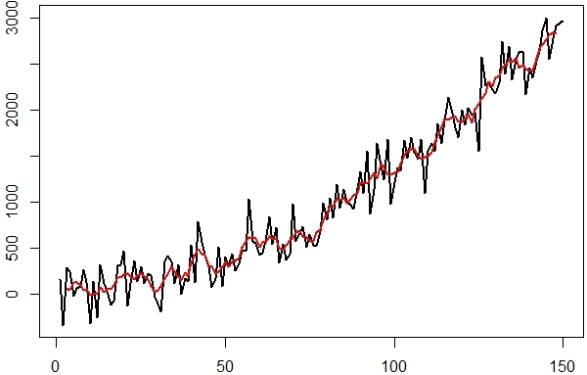
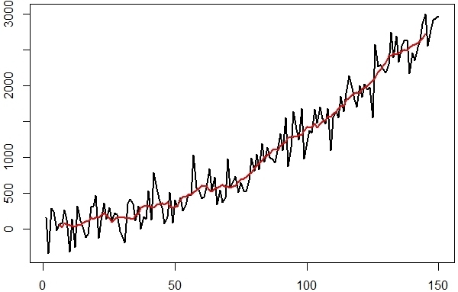
Notes:
Top Left: Actual values of the time series
Top Right: Initial time series (black) along with its moving average filter (red) of window size 3
Bot Left: Initial time series (black) along with its moving average filter (red) of window size 5
Bot Right: Initial time series (black) along with its moving average filter (red) of window size 11
You can see that averaging reduces fluctuations, we can subtract the filtered time series from initial values to remove trends. Need to do some averaging with lower window size for the beginning and end of time series to account for those lost observations

Slide 12

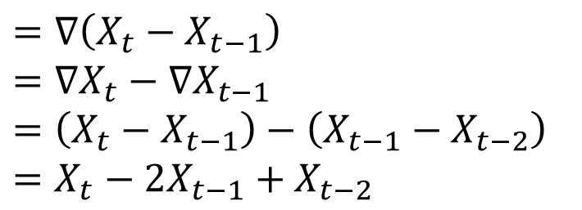
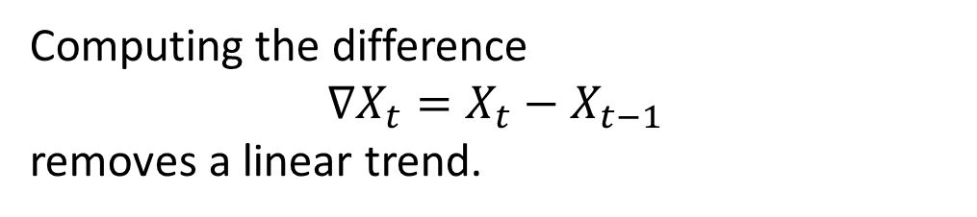

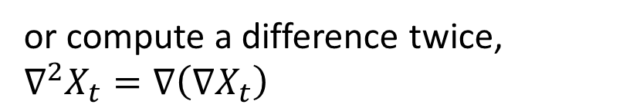





3. Differencing
Note:
• Differencing is an easy way to remove trends
• We lose one observation each time we use differencing
• A polynomial trend of order k can be removed from a time series by k times differencing
Computing the difference
$∇X_{t}=X_{t}−X_{t−1}$
removes a linear trend.
To remove a quadratic trend, compute the difference
$$∇^{2}X_{t}=X_{t}−2X_{t−1}+X_{t−2}$$
$$X_{t}=μ_{t}+ε_{t}$$
$$μ_{t}=β_{0}+β_{1} t$$
or compute a difference twice,
$$∇^{2}X_{t}=∇\left(∇X_{t}\right)$$
$$Y_{t}=X_{t}−X_{t−1}$$
$=\left(μ_{t}+ε_{t}\right)−\left(μ_{t−1}+ε_{t−1}\right)$
$$=∇\left(X_{t}−X_{t−1}\right)$$
$$=∇X_{t}−∇X_{t−1}$$
$$=\left(X_{t}−X_{t−1}\right)−\left(X_{t−1}−X_{t−2}\right)$$
$$=X_{t}−2X_{t−1}+X_{t−2}$$
$=\left(β_{0}+β_{1} t+ε_{t}\right)−\left(β_{0}+β_{1}( t−1)+ε_{t−1}\right)$
$$=β_{1}+\left(ε_{t}−ε_{t−1}\right)$$
$$=β_{1}+ε_{t}^{∗}$$
Notes:
After one difference, a quadratic trend will be reduced to a linear trend, after two differences the trend will be gone

Slide 13
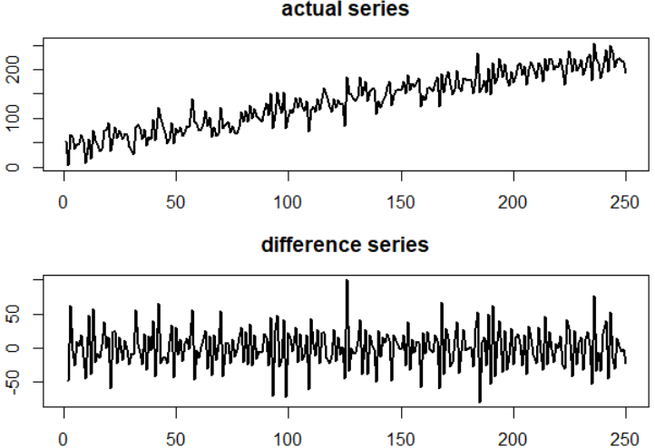
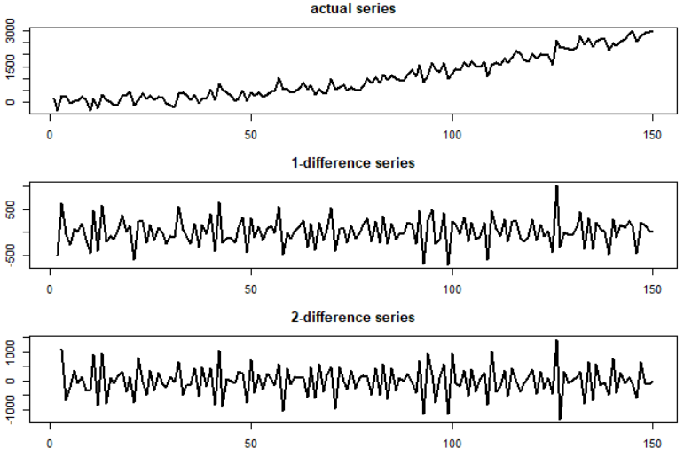








$$X_{t}=μ_{t}+ε_{t}$$
$$t=1,2,…,250$$
$$μ_{t}=40+0.75 t$$
$$ε_{t} \sim ^{i.i.d} N\left(0, 10\right)$$
$$X_{t}=μ_{t}+ε_{t}$$
$$t=1,2,…,150$$
$$μ_{t}=40+0.5 t+0.125 t^{2}$$
$$ε_{t} \sim ^{i.i.d} N\left(0, 200\right)$$
Notes:
In the second example, since the coefficient of $t^{2}$ is very small, the first difference seems to have adequately removed the quadratic trend.

Slide 14
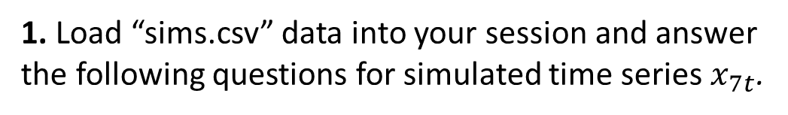
Practice Problems
1. Load “sims.csv” data into your session and answer the following questions for simulated time series $x_{7t}$.
a. Graph a time plot and describe the existing trend.
b. Estimate the trend using regression and remove it from the time series. Then plot the detrended time series and comment.
c. Perform moving average of window 15 and graph the results along the actual series, then comment.
d. Perform differencing until stationarity is achieved. Graph the final time series and comment.
e. Given results from a-d estimate all the components of this time series and write it down.
2. Repeat the same steps for $x_{8t}$in “sims.csv” dataset.
Notes:
Now it’s your turn, try to solve these problems using the techniques and codes you learned this week, discuss questions in our session

Slide 15


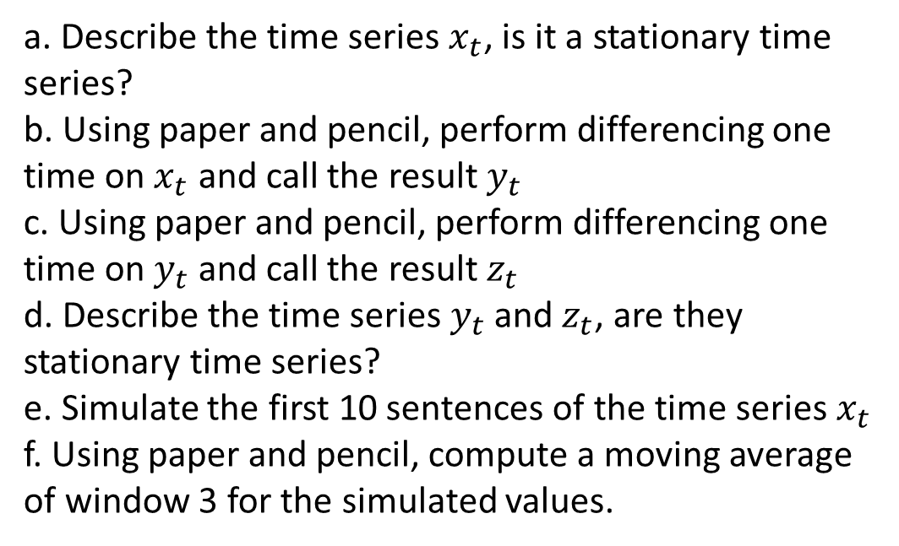
Practice Problems
3. Consider the time series
$$x_{t}=0.5−3t^{2}+ε_{t}$$
$$ε_{t} \sim ^{i.i.d} N\left(0, 1\right)$$
a. Describe the time series $x_{t}$, is it a stationary time series?
b. Using paper and pencil, perform differencing one time on $x_{t}$ and call the result $y_{t}$
c. Using paper and pencil, perform differencing one time on $y_{t}$ and call the result $z_{t}$
d. Describe the time series $y_{t}$ and $z_{t}$, are they stationary time series?
e. Simulate the first 10 sentences of the time series $x_{t}$
f. Using paper and pencil, compute a moving average of window 3 for the simulated values.

